Slide 1

Gun Violence ETL Project 2

Slide 2

Sample 1
Gun Violence ETL Project
Source Data Selection
FBI Background Check Data | Gun Violence Archive
EXTRACT • TRANSFORM • LOAD
Target Data Format
Postgres
Transformation Tool
Python | Pandas | SQLAlchemy
Establish Relationships
Date or Date Summary | Locations
Create and Populate DB
FBI NICS | Incident | Participant | URL
Join Datasets
Join on Date and State

Slide 3
Gun Violence ETL Project
Source 1
Source 2
Target 1
Target 2
Target 3
Target 4
FBI Background check DB
GVA.org
FBI NCIS
Incident
Participants
Incident URLs
PDF to CSV
CSV
PG Table
PG Table
PG Table
PG Table
Covert Source to DB Tables
Join tables for analysis

Slide 4



Project analysis slide 4
Gun Violence ETL Project
Identify Data Sources
Load Postgres Database(GunData)
Web
Scraping
Gun Violence
.org
Select Data Sources
Transform Selected Data.
FBI NICS
Table
Participant Table
CSV
Join
Gun Violence.org
.csv
Final Dataset for Analysis.
Pandas
Incident URLs Tables
Incident
Table
From PDF to CSV
FBI Background Check Database
We believe this is the superior choice however, the website has implemented several very effective safeguards against web scrapping. Several methods were attempted, including several python libraries both with and without browser , rolling IP’s, a variety of header changes but did not find a solution.

Slide 5

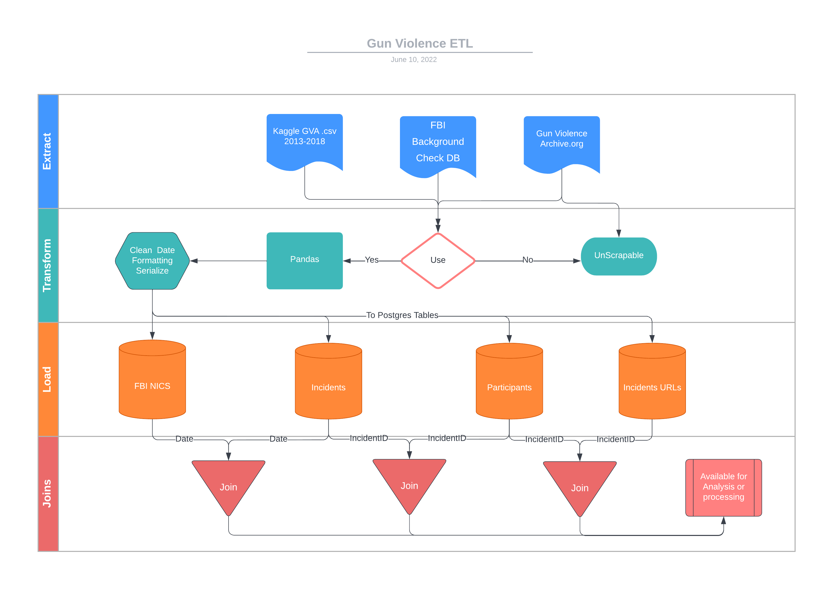

Slide 6
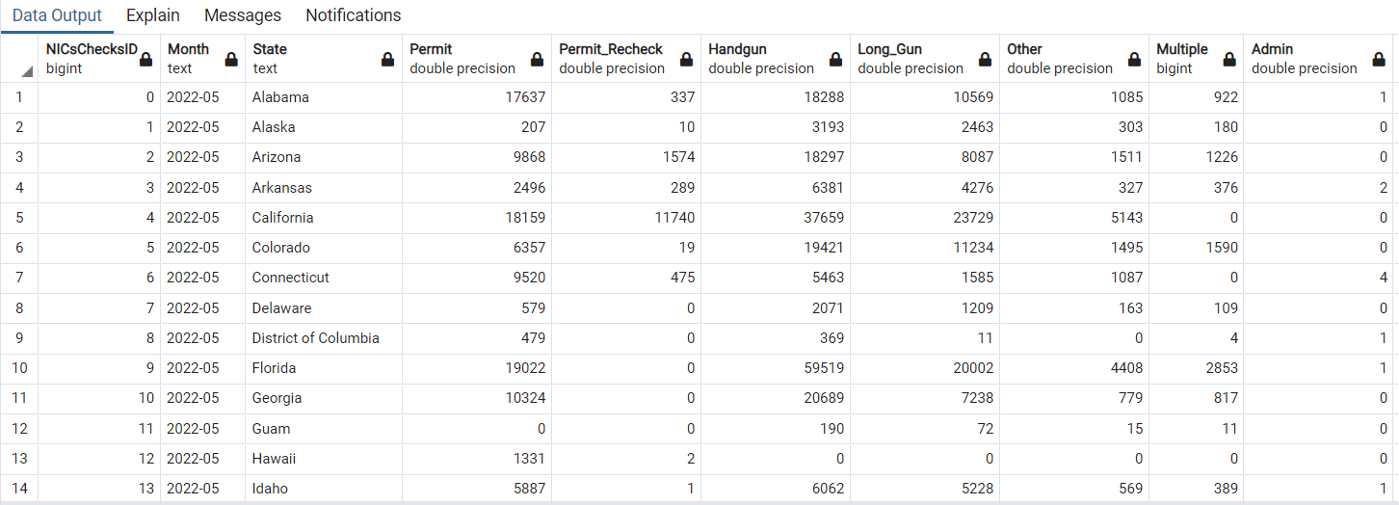
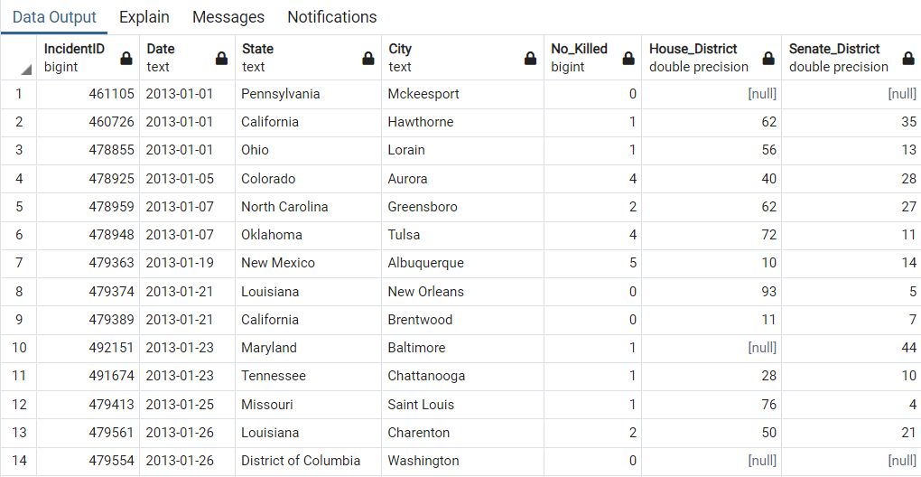
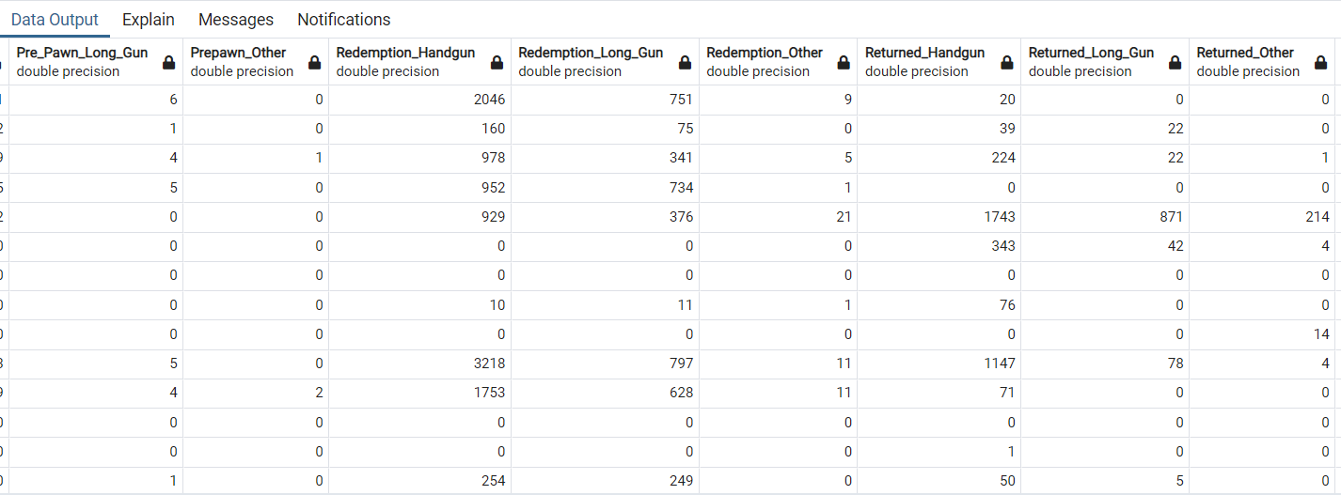
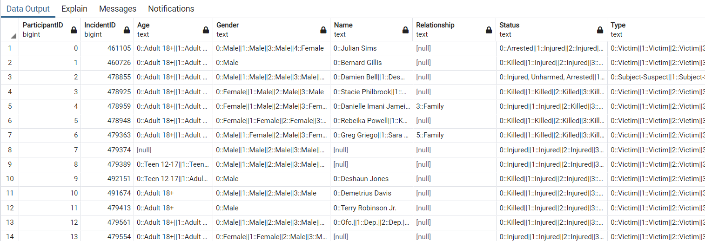
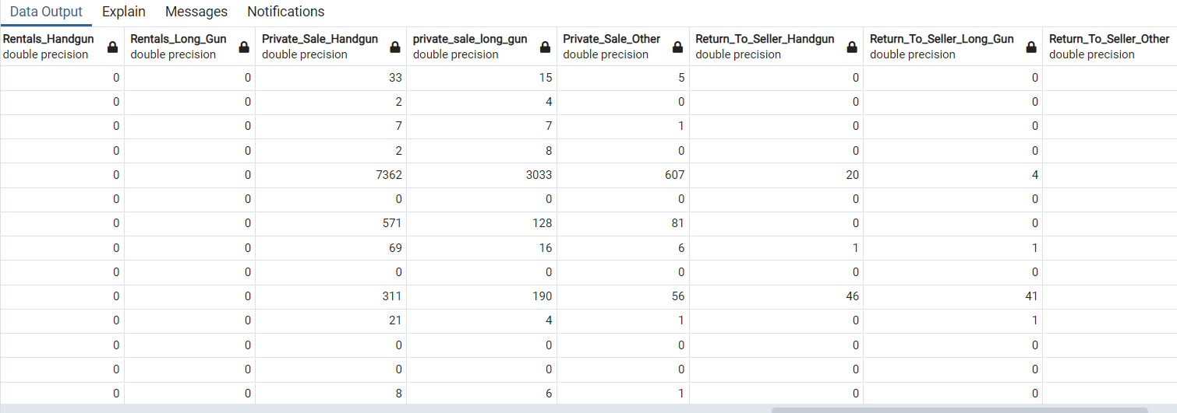
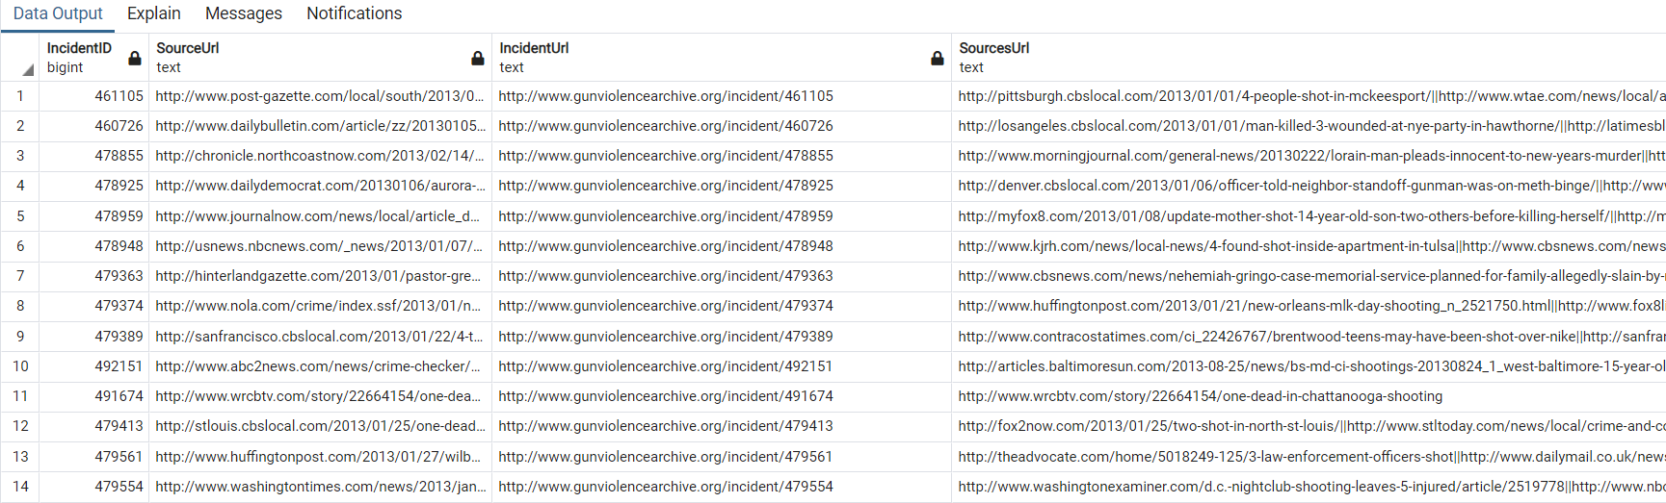
Tables

Slide 7
Project analysis slide 8
Gun Violence ETL
Tables
CREATE TABLE "Incident" (
"IncidentID" int NOT NULL,
"Date" date NOT NULL,
"State" varchar(20) NOT NULL,
"Jurisiction" varchar(20),
"Address" varchar(20),
"No_Killed" int,
"No_injured" int,
"House_District" int,
"Senate_District" int,
CONSTRAINT "pk_Incident" PRIMARY KEY (
"IncidentID"
)
);
Incident
Participants
CREATE TABLE "Participants" (
"ParticipantID" SERIAL,
"IncidentID" int not NULL,
"Age_group" varchar(10),
"Gender" varchar(10),
"Name" varchar(30),
"Realationship" varchar(30),
"Status" varchar(20),
"Type" varchar(20),
CONSTRAINT "pk_Participants" PRIMARY KEY (
"ParticipantID"
)
);
FBI NICS
Incident URLs
CREATE TABLE "FBI_NICS" (
"ID" int NOT NULL,
"Date" date NOT NULL,
"State" varchar(50) NOT NULL,
"Handgun" varchar(10) NOT NULL,
"Longgun" varchar(10) NOT NULL,
"Multiples" int NOT NULL,
"Totals" int NOT Null,
CONSTRAINT "pk_FBI_NICS"
PRIMARY KEY (
"ID"
)
);
CREATE TABLE "Incident_urls" (
"IncidentID" int NOT NULL,
"IncidentUrl" varchar(50),
"SourceUrl" varchar(50),
"SourcesUrl" varchar(50),
CONSTRAINT "pk_Incident_urls" PRIMARY KEY (
"IncidentID"
)
);

Slide 8
Thank You

